Slide 1

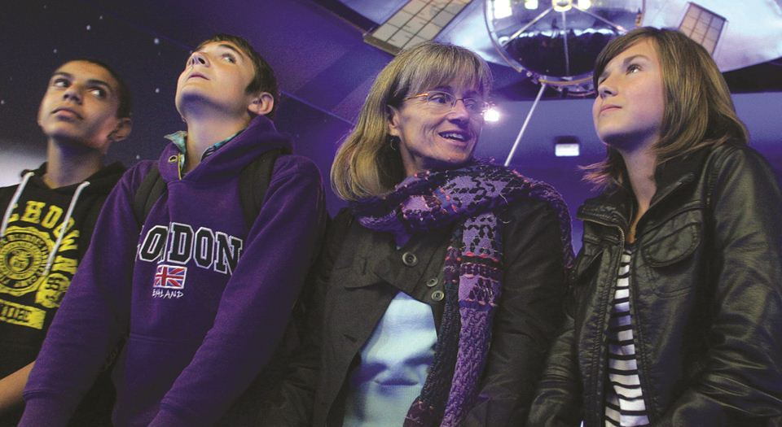
Name of Establishment
School Tours

Slide 2
Contents
About Us
Your Destination
Sample Itinerary & Accommodation
The Tour Aims & Benefits
What our customers say
Trip Resources

Slide 3
About us
Our
Experience
  Over 28 years experience in the educational travel industry with over 20,000 students traveling with us every year
  We provide safe, high-quality, competitively priced tours that support classroom learning and we’re here to help group leaders tackle all the practicalities of taking a group away
Our
Passion
  We share your passion for your subject. Most of us at Travelbound are experts in one or more subject fields, fluent in more than one language and have travelled extensively
  This mix of on-the-ground knowledge and subject expertise means we know how to make the most out of every step of your school trip
Our
Protection
  Part of Travelopia, we offer the highest level of financial protection. Travelopia’s global presence ensures that we have a year-round worldwide support network
  We are proud to have been awarded full accreditation for the LOtC Quality Badge scheme, are a full member of the School Travel Forum and fully bonded by ABTA and ATOL

Slide 4
Contents
About Us
Your Destination
Sample Itinerary & Accommodation
The Tour Aims & Benefits
What our customers say
Trip Resources

Slide 5
About Your Destination
Information

Slide 6


About Your Destination
Images of the country / city (add more slides if required)

Slide 7
Contents
About Us
Your Destination
Sample Itinerary & Accommodation
Tour Aims & Benefits
What our customers say
Trip Resources

Slide 8
Your Itinerary
Images
Day 1
Morning:
-
-
-
-
Afternoon:
-
-
-
-
Evening:
-
-
-
-

Slide 9
Your Itinerary
Images
Day 2
Morning:
-
-
-
-
Afternoon:
-
-
-
-
Evening:
-
-
-
-

Slide 10
Your Itinerary
Images
Day 3
Morning:
-
-
-
-
Afternoon:
-
-
-
-
Evening:
-
-
-
-

Slide 11
Contents
About Us
Your Destination
Sample Itinerary & Accommodation
Tour Aims & Benefits
What our customers say
Trip Resources

Slide 12
Aims & Benefits
Aim of Trip
Benefit of Trip

Slide 13
Contents
About Us
Your Destination
Sample Itinerary & Accommodation
    Tour Aims & Benefits
What our customers say
Trip Resources

Slide 14
Our Feedback

Slide 15
Contents
About Us
Your Destination
Sample Itinerary & Accommodation
    Tour Aims & Benefits
What our customers say
      Trip Resources

Slide 16
Trip Resources
Trip Resources

Slide 17

Enjoy your trip…

